Slide 1
Poems and Early Child Language Development
Zhen Jiang
May 13, 2020

Slide 2
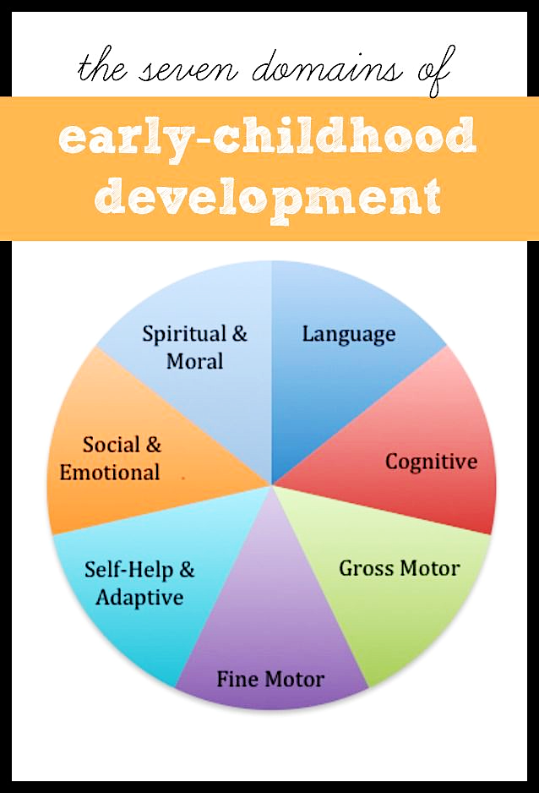
Introduction
Poetry
Effective: simplicity and brevity of thought.
Helps children pay attention to the patterns of language & encourages vocabulary.
Aims
Emphasis on teaching
Provide suggestions for early child language educator regarding
Diff. between genders
Emotional change

Slide 3
Dataset
Poki Dataset (11MB)
https://github.com/whipson/PoKi-Poems-by-Kids/blob/master/README.md
Variable Name | Means
id | unique identifier for each poem
grade | school grade (1-12)
author | first name of author
valence | Means valence
arousal | Means arousal
dominance | Means dominance
anger | Means anger
fear | Means fear
sadness | Means sadness
joy | Means joy
total words | total number of non stop words within poem
gender | probable gender based on author name
A corpus of 61,330 poems.
Written by children from grades 1 to 12.
Especially useful in studying child language.
Emotional words:
Scored by intensity analyzed by the NRC Emotion Intensity lexicon.

Slide 4
Data Analysis
Aim 1
Visualize change in the total number of words in a poem
View by gender
Figure 2
Figure 1

Slide 5
Data Analysis
Figure 3
Aim 2
Visualize the amount of submitted poems
Grade 4 ~ 6: more active poem writers.
Grade 3: increased dramatically.
Grade 8: dropped obviously.
Gender: female submitted more poems.

Slide 6
Data Analysis
Figure 4
Aim 3
Visualize the trends of emotional change

Slide 7
Summary
Children from grade 3 start to develop more interest in writing poems.
Female show more interest at writing poems than males do.
More emphasis on language education starting at grade 3.
Develop language skills more efficiently.
When children grow up:
Ability of writing longer poems is improved.
Words usage to express emotion is changed as well.
Improved ability of manipulating language (vocabulary) as children grow up.

Slide 8
Thanks for your attentions!

